Slide 1

Module-5 Pointer and Working with Strings
Subject : Fundamentals of Programming using C
Code : 15101104
Asst. Prof. Bhavika Vaghela, FITCS, PICA, BCA, Parul University

Slide 2
Topics
Understanding pointers, Accessing the address of a variable
Declaring & initializing pointers, Accessing a variable through its pointer
Pointer expression, Pointer increments & scale factor
Pointers & arrays, Passing pointer variables as function arguments.
Declaring & initializing string variables
Reading strings from terminal
Writing strings to screen, Arithmetic operations on characters, putting strings together
Comparison of two strings, string handling functions, table of strings.

Slide 3
Chapter 1: Understanding Pointers
Each variable is assigned a memory slot (the size depends on the data type) and the variable’s data is stored at that place.
int a = 100;
1020
1024
1032
…
…
100
…
1024
…
a
Variable a’s value, i.e., 100, is
stored at memory location 1024

Slide 4
Pointer
A pointer is a variable used to store the address of a memory cell.
We can use the pointer to reference this memory cell
Memory address:
1020
1024
1032
…
…
100
…
1024
…
integer
pointer

Slide 5
Pointer Types
C has pointer types for each type of object
Pointers to int objects
Pointers to char objects
Pointers to user-defined objects
(e.g., RationalNumber)
Even pointers to pointers
Pointers to pointers to int objects

Slide 6
Pointer Variable
Declaration of Pointer variables
type* pointer_name;
//or
type *pointer_name;
Where type is the type of data pointed to (e.g. int, char, double)
Examples:
int *n;
RationalNumber *r;
int **p; // pointer to pointer

Slide 7
Chapter 2: Address Operator ‘&’
The "address of " operator (&) gives the memory address of the variable
Usage: &variable_name
int a = 100;
//get the value,
printf(“%d”,a); //prints 100
//get the memory address
printf(“%d”,&a); //prints 1024
1020
1024
…
…
100
…
…
…

Slide 8
Address Operator &
#include <iostream>
using namespace std;
void main()
{
int a, b; a = 88; b = 100;
printf("The address of a is: %d“,&a);
printf("The address of b is: %d”,&b);
}
Memory address:
1020
1024
1032
…
88
100
…
…
…
a
b
Result is:
The address of a is: 1020
The address of b is: 1024

Slide 9
Chapter 3: Pointer Variables
The value of pointer p is the address of variable a
A pointer is also a variable, so it has its own memory address
Memory address:
1020
1024
1032
…
88
100
…
1024
…
a
p
Result is:
100 1024
1024 1032
int a = 100;
int *p = &a;
printf(“%d %d %d %d”, a, &a, &p, p);

Slide 10
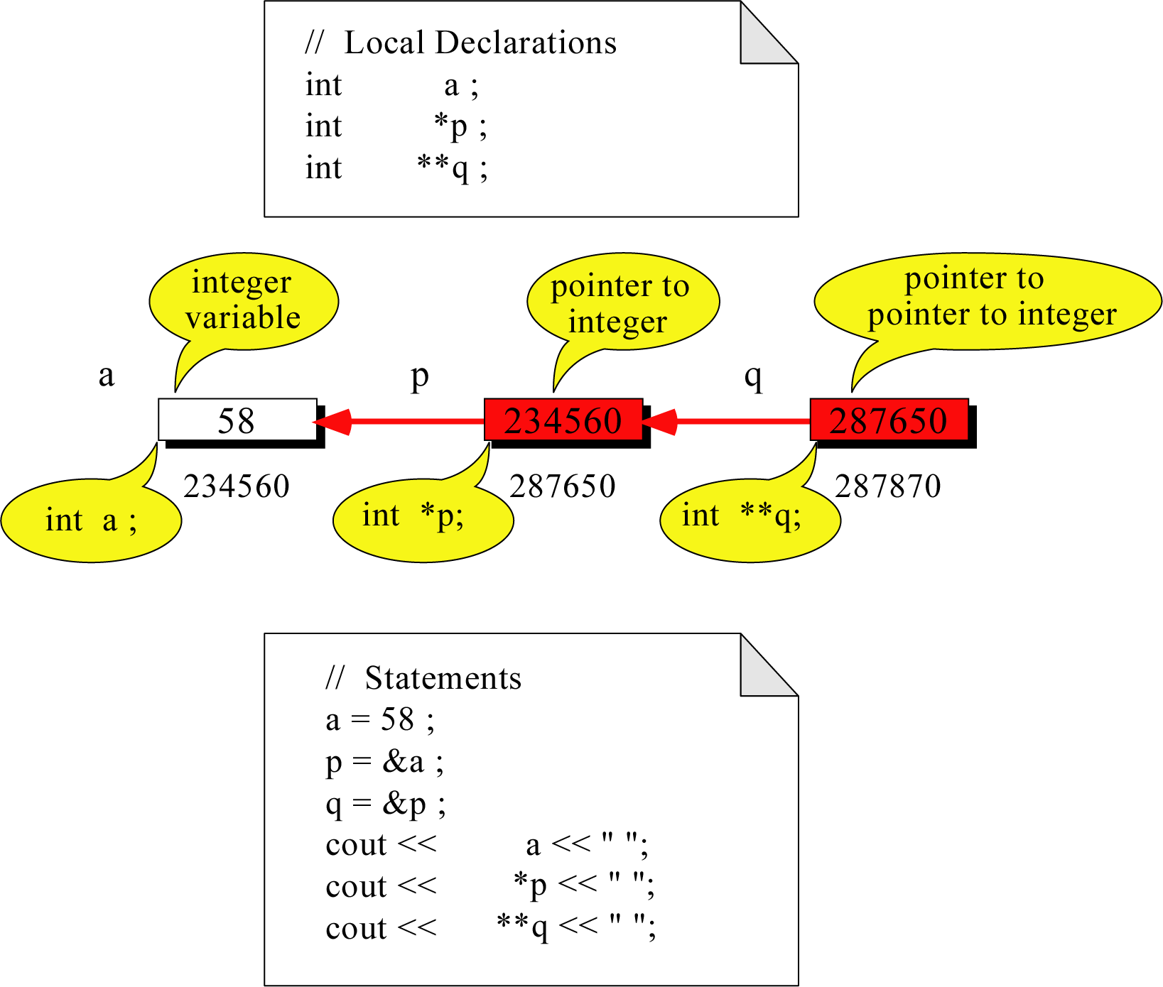
Pointer to Pointer
What is the output?
58 58 58

Slide 11
Dereferencing Operator *
We can access to the value stored in the variable pointed to by using the dereferencing operator (*)
Memory address:
1020
1024
1032
…
88
100
…
1024
…
a
p
int a = 100;
int *p = &a;
cout << a << endl;
cout << &a << endl;
cout << p << " " << *p << endl;
cout << &p << endl;
Result is:
100
1024
1024 100
1032

Slide 12
Don’t get confused
Declaring a pointer means only that it is a pointer: int *p;
Don’t be confused with the dereferencing operator, which is also written with an asterisk (*). They are simply two different tasks represented with the same sign
int a = 100, b = 88, c = 8;
int *p1 = &a, *p2, *p3 = &c;
p2 = &b; // p2 points to b
p2 = p1; // p2 points to a
b = *p3; //assign c to b
*p2 = *p3; //assign c to a
cout << a << b << c;
Result is:
888

Slide 13
A Pointer Example
The code
void doubleIt(int x, int * p)
{
*p = 2 * x;
}
void main()
{
int a = 16;
doubleIt(9, &a);
}
Memory Layout
Box diagram
main
16
p (8200)
8192
a
doubleIt
x (8196)
9
a (8192)
16
main
doubleIt
x
9
a gets 18
p

Slide 14
Another Pointer Example
#include <iostream>
using namespace std;
void main (){
int value1 = 5, value2 = 15;
int *p1, *p2;
p1 = &value1; // p1 = address of value1
p2 = &value2; // p2 = address of value2
*p1 = 10; // value pointed to by p1=10
*p2 = *p1; // value pointed to by p2= value // pointed to by p1
p1 = p2; // p1 = p2 (pointer value copied)
*p1 = 20; // value pointed to by p1 = 20
cout << "value1==" << value1 << "/ value2==" << value2;
getch();
}
Let’s figure out:
value1==? / value2==?
Also, p1=? p2=?

Slide 15
Another Pointer Example
int a = 3;
char s = ‘z’;
double d = 1.03;
int *pa = &a;
char *ps = &s;
double *pd = &d;
sizeof returns the # of bytes…
cout << sizeof(pa) << sizeof(*pa)
<< sizeof(&pa) << endl;
cout << sizeof(ps) << sizeof(*ps)
<< sizeof(&ps) << endl;
cout << sizeof(pd) << sizeof(*pd)
<< sizeof(&pd) << endl;

Slide 16
Chapter 4: Reference Variables
A reference is an additional name to an existing memory location
Pointer:
Reference:
x
9
x
ref
9
ref
int x = 9;
int &ref = x;
int x=9;
int *ref;
ref = &x;

Slide 17
Reference Variables
A reference variable serves as an alternative name for an object
int m = 10;
int &j = m; // j is a reference variable
cout << “value of m = “ << m << endl;
//print 10
j = 18;
cout << “value of m = “ << m << endl;
// print 18

Slide 18
Reference Variables
A reference variable always refers to the same object. Assigning a reference variable with a new value actually changes the value of the referred object.
Reference variables are commonly used for parameter passing to a function

Slide 19
Traditional Pointer Usage
void IndirectSwap(char *Ptr1, char *Ptr2)
{
char temp = *Ptr1;
*Ptr1 = *Ptr2;
*Ptr2 = temp;
}
int main() {
char a = 'y';
char b = 'n';
IndirectSwap(&a, &b);
cout << a << b << endl;
return 0;
}

Slide 20
Pass by Reference
void IndirectSwap(char& y, char& z) {
char temp = y;
y = z;
z = temp;
}
int main() {
char a = 'y';
char b = 'n';
IndirectSwap(a, b);
cout << a << b << endl;
return 0;
}

Slide 21
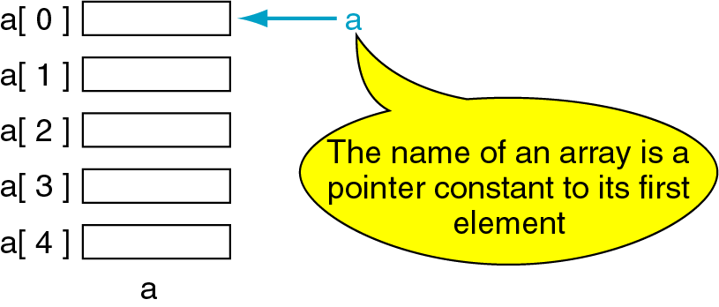
Chapter 5: Pointers and Arrays
The name of an array points only to the first element not the whole array
1000
1004
1008
1012
1016

Slide 22
Array Name is a Pointer Constant
#include <iostream.h>
using namespace std;
void main ()
{ int a[5];
cout << "Address of a[0]: " << &a[0] << endl
<< "Name as pointer: " << a << endl;
}
Result:
Address of a[0]: 0x0065FDE4
Name as pointer: 0x0065FDE4

Slide 23
Dereferencing An Array Name
#include <iostream.h>
using namespace std;
This element is called a[0] or *a
#include <iostream.h>
using namespace std;
void main(){
int a[5] = {2,4,6,8,22};
cout << *a << " "
<< a[0];
} //main
a[0]
2
a
a[1]
4
a[2]
6
a[3]
8
a[4]
22
a

Slide 24

Chapter 6: Array Names as Pointers
To access an array, any pointer to the first element can be used instead of the name of the array
We could replace *p by *a
#include <stdio.h>
void main(){
int a[5] = {2,4,6,8,22};
int *p = a;
printf(“%d”,*p);
printf(“%d”,a[i]);
}
a
p
2 2
a[0]
2
a[1]
4
a[2]
6
a[3]
8
a[4]
22
a

Slide 25
Multiple Array Pointers
Both ‘a’ and ‘p’ are pointers to the same array
4 4
#include <iostream.h>
using namespace std;
void main(){
int a[5] = {2,4,6,8,22};
int *p = &a[1];
cout << a[0] << " "
<< p[-1];
cout << a[1] << " "
<< p[0];
}
a[0]
a[0]
2
p
a[1]
4
a[2]
6
p[0]
a[3]
8
a[4]
22

Slide 26
Pointer Arithmetic
Given a pointer p, p+n refers to the element that is offset from p by n positions.
a
2
p - 1
a + 1
4
p
a + 2
6
p + 1
8
p + 2
a + 3
22
p + 3
a + 4

Slide 27
Dereferencing Array Pointers
Given a pointer p, p+n refers to the element that is offset from p by n positions.
a[0] or *(a + 0)
2
a
a[1] or *(a + 1)
4
a + 1
a[2] or *(a + 2)
6
a + 2
a[3] or *(a + 3)
8
a + 3
a[4] or *(a + 4)
22
a + 4

Slide 28
Array of Pointers & Pointers to Array
Given a pointer p, p+n refers to the element that is offset from p by n positions
a
p
b
c
A pointer to an array
An array of Pointers
int list[5] = {9, 8, 7, 6, 5};
int *p;
P = list;//points to 1st entry
P = &list[0];//points to 1st entry
P = &list[1];//points to 2nd entry
P = list + 1; //points to 2nd entry
int a = 1, b = 2, c = 3;
int *p[5];
p[0] = &a;
p[1] = &b;
p[2] = &c;

Slide 29
NULL pointer
NULL is a special value that indicates an empty pointer
If you try to access a NULL pointer, you will get an error
int *p;
p = 0;
cout << p << endl; //prints 0
cout << &p << endl;//prints address of p
cout << *p << endl;//Error!

Slide 30
Storing 2D Array in 1D Array
int twod[3][4] = {{0,1,2,3}, {4,5,6,7},
{8,9,10,11}};
int oned[12];
for(int i=0; i<3; i++)
{
for(int j=0; j<4 ; j++)
oned[i*4+j] = twod[i][j]; }

Slide 31
Pointer to 2-Dimensional Arrays
table
table[i] = &table[i][0] refers to the address of the ith row
table[ 0] or *( table + 0 )
table + 1
table + 2
table[ 1] or *( table + 1 )
What is
**table ?
table[ 2] or *( table + 2 )
*(table[i]+j)
= table[i][j]
int table[3][4] = {{1,2,3,4},
{5,6,7,8},{9,10,11,12}};
for(int i=0; i<3; i++){
for(int j=0; j<4; j++)
cout << *(*(table+i)+j);
cout << endl;
}

Slide 32
Chapter 7: Dynamic Objects / Memory Management
Static Memory Allocation
Memory is allocated at compilation time
Dynamic Memory
Memory is allocated at running time

Slide 33
Static vs. Dynamic Objects
Static object
(variables as declared in function calls)
Memory is acquired automatically
Memory is returned automatically when object goes out of scope
Dynamic object
Memory is acquired by program with an allocation request
new operation
Dynamic objects can exist beyond the function in which they were allocated
Object memory is returned by a deallocation request
delete operation

Slide 34
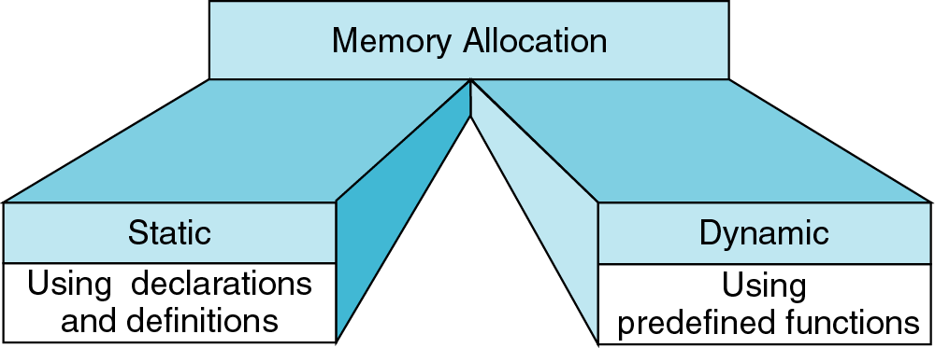
Memory Allocation
{
int a[200];
…
}
int* ptr;
ptr = new int[200];
…
delete [] ptr;
new
delete

Slide 35
Object (variable) Creation: New
Syntax
ptr = new SomeType;
where ptr is a pointer of type SomeType
Example
int* p = new int;
Uninitialized int variable
p

Slide 36
Allocation of Memory using new Keyword
int *ptr = new int;
//We can declare a variable while dynamical allocation in the following two ways.
int *ptr = new int (10);
int *ptr = new int {15};
// new operator is also used to allocate a block(an array) of memory of type data-type.
int *ptr = new int[20];
// The above statement dynamically allocates memory for 20 integers continuously of type int and returns a pointer to the
first element of the sequence to ‘ptr’ pointer.

Slide 37
Object (variable) destruction: Delete
Syntax
delete p;
storage pointed to by p is returned to free store and p is now undefined
Example:
int* p = new int;
*p = 10;
delete p;
P
10

Slide 38
Deallocation of memory using delete Keyword
delete ptr;
delete[ ] ptr;

Slide 39
Array of New: dynamic arrays
Syntax
P = new SomeType[Expression];
Where
P is a pointer of type SomeType
Expression is the number of objects to be constructed -- we are making an array
Because of the flexible pointer syntax, P can be considered to be an array

Slide 40
Example
Dynamic Memory Allocation
Request for “unnamed” memory from the Operating System
int *p, n=10;
p = new int;
p = new int[100];
p = new int[n];
new
p
new
p
100
new
p
N

Slide 41
Dynamically Allocating Arrays
#include <iostream>
using namespace std;
int main()
{
int len, sum = 0;
out << "Enter the no. of students in the class" << endl; cin >> len;
int *marks = new int[len]; //Dynamic memory allocation
cout << "Enter the marks of each student" << endl;

Slide 42
Dynamically Allocating Arrays
for( int i = 0; i < len; i++ )
{
cin >> *(marks+i);
}
for( int i = 0; i < len; i++ )
{
sum += *(marks+i);
}
cout << "sum is " << sum << endl;
return 0;
}

Slide 43
Dangling Pointer Problem
int *A = new int[5];
for(int i=0; i<5; i++)
A[i] = i;
int *B = A;
A
B
Now, These locations can’t be accessed by the program
delete [] A; A
B[0] = 1; // illegal! B
0 | 1 | 2 | 3 | 4
?

Slide 44
Memory Leak Problem
int *A = new int [5];
for(int i=0; i<5; i++)
A[i] = i;
A
//Now, These Locations are can’t be accessed by program
A = new int [5];
A
0 | 1 | 2 | 3 | 4
0 | 1 | 2 | 3 | 4
- | - | - | - | -

Slide 45
A Dynamic 2D Array
A dynamic array is an array of pointers to save space when not all rows of the array are full
int **table;
Table[0]
Table[1]
Table[2]
Table[3]
Table[4]
Table[5]
32 | 18 | 12 | 24
13
13 | 11 | 16 | 12 | 42 | 19 | 14
22
13
13
14
11
18
table = new int*[6];
…
table[0] = new int[4];
table[1] = new int[7];
table[2] = new int[1];
table[3] = new int[3];
table[4] = new int[2];
table[5] = NULL;
X

Slide 46
Memory Allocation
int **table;
table = new int*[6];
table[0]= new int[3];
table[1]= new int[1];
table[2]= new int[5];
table[3]= new int[10];
table[4]= new int[2];
table[5]= new int[6];
table[0][0] = 1; table[0][1] = 2; table[0][2] = 3;
table[1][0] = 4;
table[2][0] = 5; table[2][1] = 6; table[2][2] = 7; table[2][3] = 8; table[2][4] = 9;
table[4][0] = 10; table[4][1] = 11;
cout << table[2][5] << endl;

Slide 47
Memory Deallocation
Memory leak is a serious bug!
Each row must be deleted individually
Be careful to delete each row before deleting the table pointer.
for(int i=0; i<6; i++)
delete [ ] table[i];
delete [ ] table;

Slide 48
Create a matrix of any dimensions, m by n
Simple matrix
int m, n;
cin >> m >> n >> endl;
int** mat;
mat = new int*[m];
for (int i=0;i<m;i++)
{
mat[i] = new int[n];
}
Using Function
int m, n;
cin >> m >> n >> endl;
int** mat;
mat = imatrix(m,n);
…
int** imatrix(nr, nc) {
int** m;
m = new int*[nr];
for (int i=0;i<nr;i++)
m[i] = new int[nc];
return m;
}

Slide 49
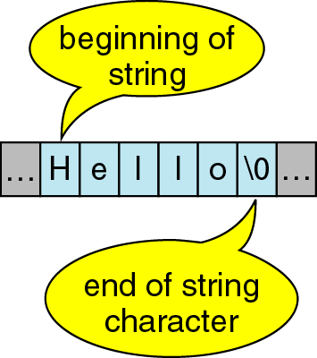
Chapter 8: Strings in ‘C’
A sequence of characters is often referred to as a character “string”
A string is stored in an array of type char ending with the null character '\0 ‘

Slide 50
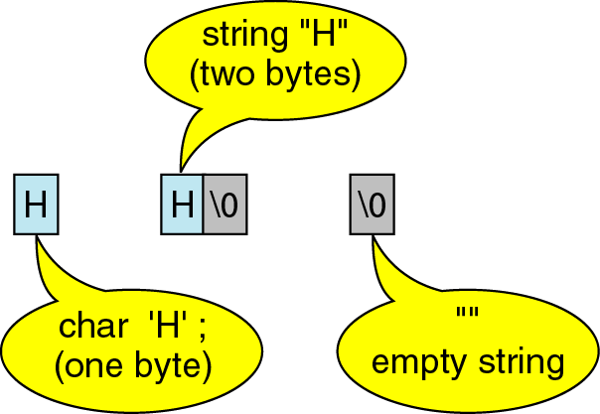
Strings in ‘C’
A string containing a single character takes up 2 bytes of storage

Slide 51
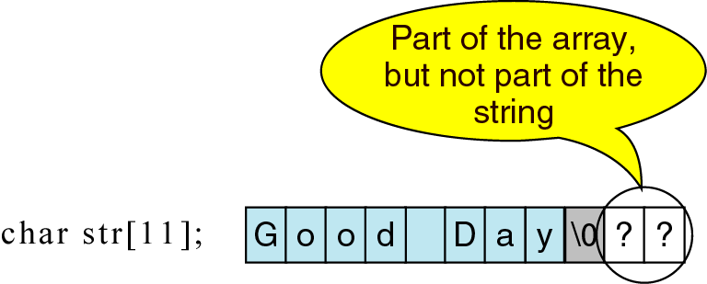
Character Strings
A string containing a single character takes up 2 bytes of storage

Slide 52
Character vs. String
A string containing a single character takes up 2 bytes of storage
A string constant is a sequence of characters enclosed in double quotes.
For example, the character string:
char s1[2]="a"; //Takes two bytes of storage.
s1:
On the other hand, the character, in single quotes:
char s2= `a`; //Takes only one byte of storage.
s2:
a | \0
a

Slide 53
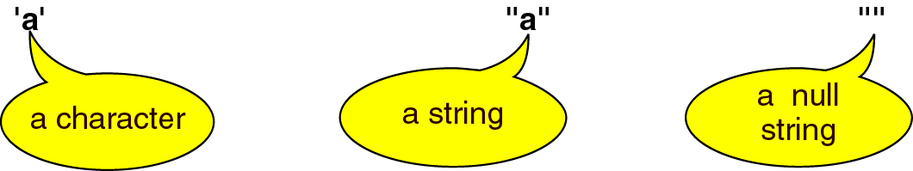
Character vs. String

Slide 54
Example
char message1[12] = "Hello world";
cout << message1 << endl;
message1:
char message2[12];
cin >> message2; // type "Hello" as input
message2:
H | e | l | l | o |  | w | o | r | l | d | \0
H | e | l | l | o | \0

Slide 55
Chapter 9: Reading string Example 2 String I/O
String can be input using the extraction operator >>, but one or more white spaces indicates the end of an input string.
char A_string[80], E_string[80];
cout << "Enter some words in a string:\n";
cin >> A_string >> E_string;
cout << A_string << E_string << “\nEND OF OUTPUT\n";
Output:
Enter some words in a string:
This is a test.
Thisis
END OF OUTPUT

Slide 56
getline() function
The function getline can be used to read an entire line of input into a string variable.
The getline function has three parameters:
The first specifies the area into which the string is to be read.
The second specifies the maximum number of characters, including the string delimiter.
The third specifies an optional terminating character. If not included, getline stops at ‘\n’

Slide 57
Example 3: using getline function
char A_string[80];
cout << "Enter some words in a string:\n";
//80 is the size of A_string
cin.getline(A_string, 80);
cout << A_string << “\nEND OF OUTPUT\n";
Output:
Enter some words in a string:
This is a test.
This is a test.
END OF OUTPUT

Slide 58
Example 4: getline() Example
char A_string[5], E_string[80];
cout << "Enter some words in a string:\n";
cin >> A_string;
cin.getline (E_string, 9) ;
cout << A_string << "#" << E_string
<< “\nEND OF OUTPUT\n";
Output:
Enter some words in a string:
This is a test.
This# is a te
END OF OUTPUT

Slide 59
Example 5: getline Example
char lastName[30], firstName[30];
cout << "Enter a name <last,first>:\n";
cin.getline (lastName, sizeof(lastName), ',');
cin.getline (firstName, sizeof(firstName));
cout << "Here is the name you typed:\n\t|"
<< firstName << " " << lastName << "|\n";
Output:
Enter a name in the form <last,first>:
Chan,Anson
Here is the name you typed:
|Anson Chan|

Slide 60
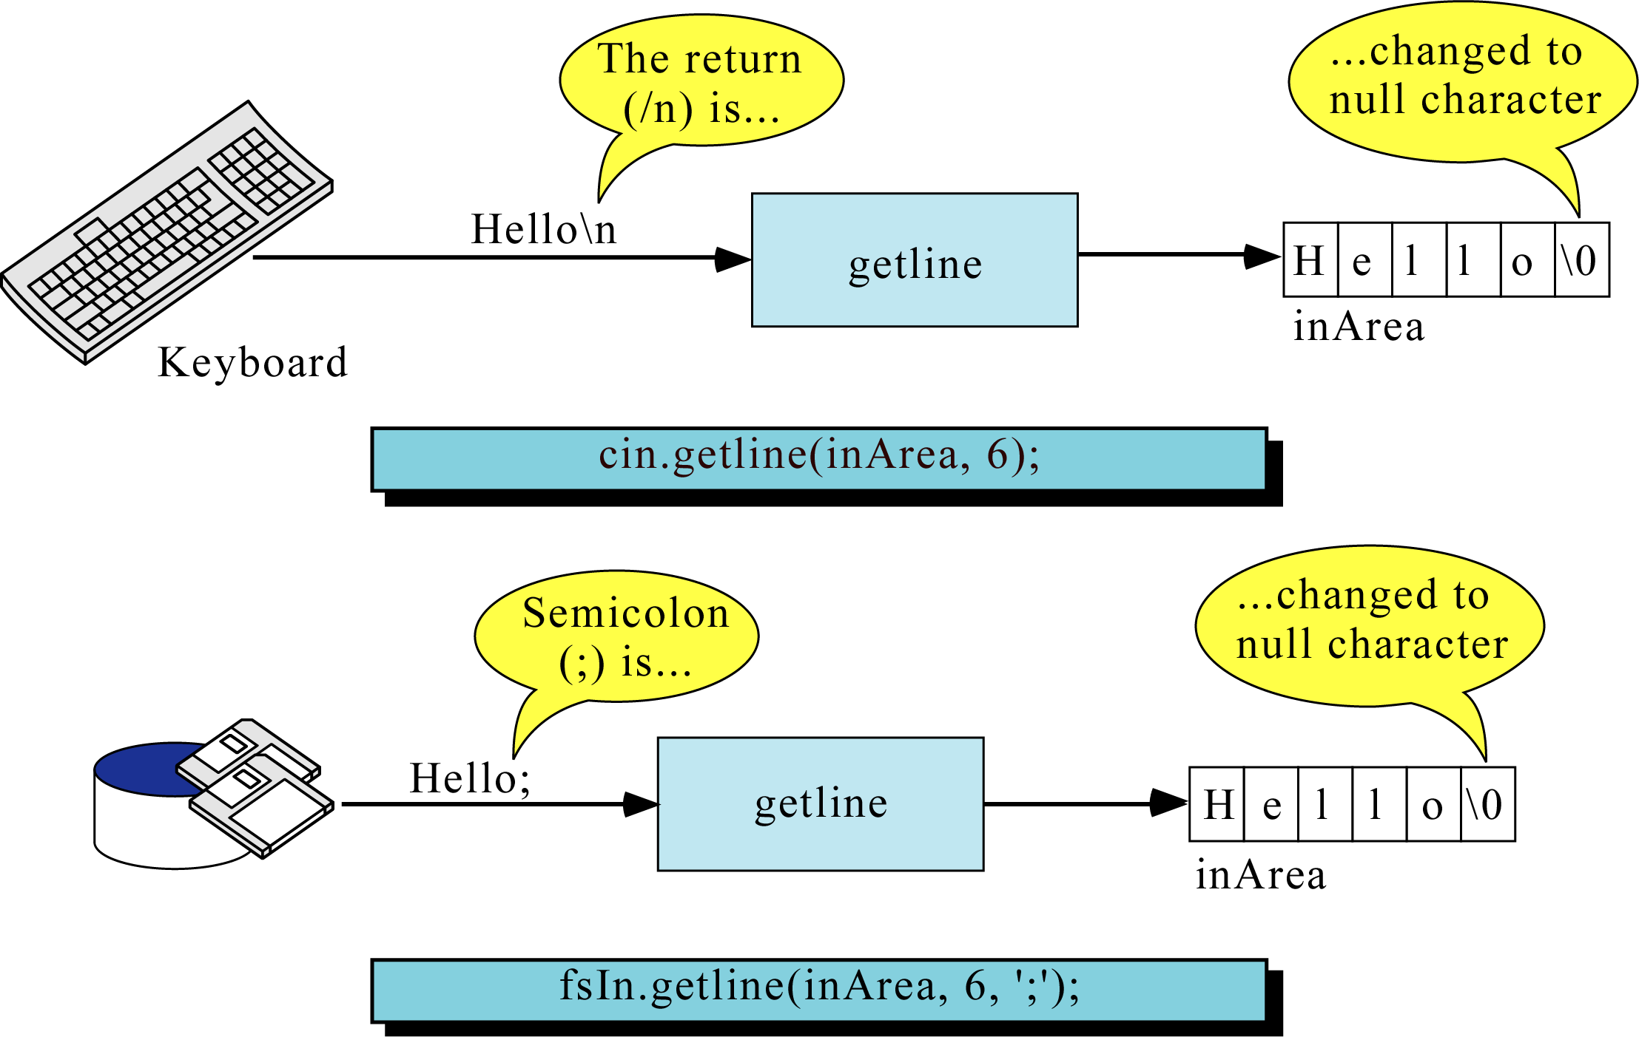
fsln.getline()

Slide 61
Chapter 10: Ex. 6: String Copy Function in <cstring>
void strcpy(char dest[], const char src[]); //copies string src into string dest
example:
char name1[16], name2[16];
strcpy(name1,"Chan Tai Man");
name1:
name2:
name2:
C | h | a | n |  | T | a | i |  | M | a | n | \0 | ? | ? | ?
strcpy(name2,"999999999999999");
9 | 9 | 9 | 9 | 9 | 9 | 9 | 9 | 9 | 9 | 9 | 9 | 9 | 9 | 9 | \0
strcpy(name2,name1);
C | h | a | n |  | T | a | i |  | M | a | n | \0 | 9 | 9 | \0

Slide 62
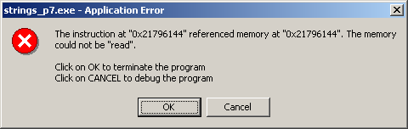
Example 7: strcpy in <cstring>
#include <iostream>
#include <cstring>
using namespace std;
int main (){
char string_1[6] = "Short"; // character strings
char string_2[17] = "Have a Nice Day";
char string_3[6] = "Other";
strcpy(string_1, string_2);
return 0;
}

Slide 63
Ex. 8: String Length Check Function in <cstring>
// string prototype, already included in string.h
//returns length of string(not counting'\0‘)
//you don't need to include it in your program
Example
int strlen(const char[]);
int string_length = strlen("abcde");
cout<<“String length is:”<<string_length;
//string_length is set to 5.
Output
String length is:5

Slide 64
Ex. 9: String Length Check Function Example
#include <iostream>
#include <cstring>
using namespace std;
void main(){ char string_1[5] = "ABCD", string_2[10]="123456789";
cout << "String 1 = " << string_1 << endl;
cout << "String 2 = " << string_2 << endl;
strncpy(string_1,string_2,strlen(string_1));
cout << "After copying, string 1 = " << string_1<<endl;
}
Output: String 1 = ABCD
String 2 = 123456789
After copying, string 1 = 1234

Slide 65
Ex. 10: Create String copy function
//Copy the value of a string to a string variable
#include <iostream>
#include <string>
using namespace std;
void string_copy(char target[], const char source[],
int target_size);
//Before: target_size is the declared size of target.
//not including '\0'.
//After: The value of target has been set to the string
//value in source, provided the declared size of
//target is large enough. If target is not large
//enough to hold the entire string, a string
//equal to the length of target will be stored.

Slide 66
Ex. 10: Create String copy function
int main( ) //Driver function
{
char short_string[11];
char long_string[] = "This is rather long.";
cout << long_string << "STRING ENDS HERE.\n";
string_copy(short_string, "Hello", 10);
cout << short_string << "STRING ENDS HERE.\n";
string_copy(short_string, long_string, 10);
cout << short_string << "STRING ENDS HERE.\n";
return 0;
}

Slide 67
Ex. 10: Create String copy function
//Uses string.h:
void string_copy(char target[], const char source[],int target_size)
{
int index;
int new_length = strlen(source);
if (new_length > (target_size))
new_length = target_size ;
for (index = 0; index < new_length; index++)
target[index] = source[index];
target[index] = '\0';
}

Slide 68
Ex. 10: Create String copy function
Output:
This is rather long.STRING ENDS HERE.
HelloSTRING ENDS HERE.
This is raSTRING ENDS HERE.

Slide 69
Chapter 11: String Comparison
int strcmp(char s1[], char s2[]);
/*compares strings s1 and s2, returns
< 0 if s1 < s2
= 0 if s1 == s2 (i.e. strcmp returns false)
> 0 if s1 > s2
*/
int strncmp(char s1[], char s2[], int limit);
/* Same as strcmp except that at most limited characters are compared. */

Slide 70
Create String Comparison fucntion
int comp102_strncmp(char s1[], char s2[], int limit)
{
for (int i=0; i < limit; i++)
{
if (s1[i] < s2[i])
return -1;
if (s1[i] > s2[i])
return 1;
}
return 0;
}

Slide 71
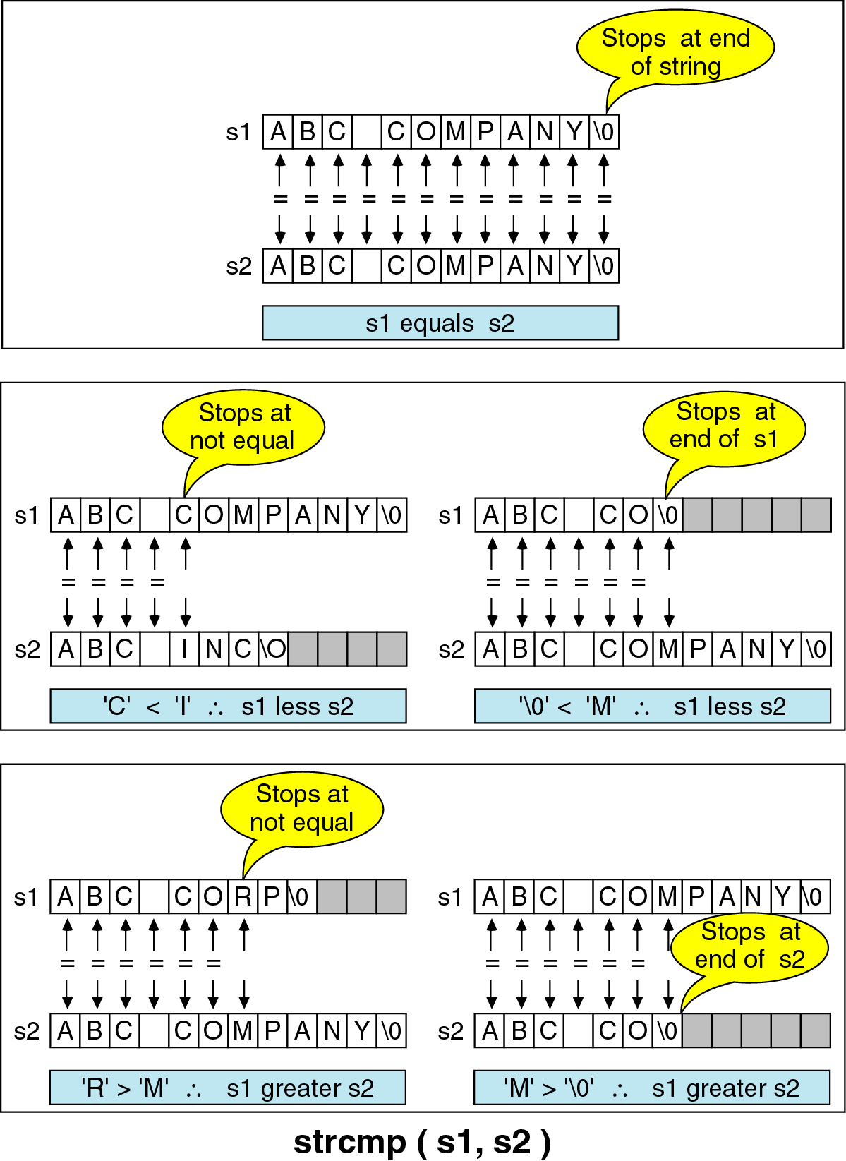
Comparison Example

Slide 72
Ex. 11: String Comparison Examples
str1 | str2 | return value | reason
“AAAA” | “ABCD” | <0 | ‘A’ <‘B’
“B123” | “A089” | >0 | ‘B’ > ‘A’
“127” | “409” | <0 | ‘1’ < ‘4’
“abc888” | “abc888” | =0 | equal string
“abc” | “abcde” | <0 | str1 is a sub string of str2
“3” | “12345” | >0 | ‘3’ > ‘1’

Slide 73
Chapter 12: Ex. 12: Example to take string and print
#include<iostream>
#include<cstring>
#include<string.h>
using namespace std;
int main()
{
string str;
str="hello";
cout << str;
return 0;
}
Output: Hello

Slide 74
Some Common Errors
It is illegal to assign a value to a string variable (except at declaration).
char A_string[10];
// A_string = "Hello"; // illegal assignment
/*error: incompatible types in assignment of ‘const char [6]’ to ‘char [10]’ */
//should use instead
strcpy (A_string, "Hello");
Output: Hello

Slide 75
Some Common Errors
The operator == doesn't test two strings for equality.
if (string1 == string2) //wrong
cout << "Yes!";
// illegal comparison
Should use instead
int main()
{ const char *str="Hello";
const char *str2="Hello";
if(!strcmp(str,str2))
cout<<"same";
else
cout<<"notsame";
} Output: same

Slide 76
Thank You....

